Slide 1
1. How many users do we have who have made a purchase only once?
93049 users have done purchase only one time. All amount of users is 96096.

Slide 2
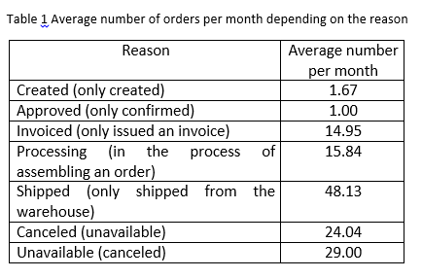
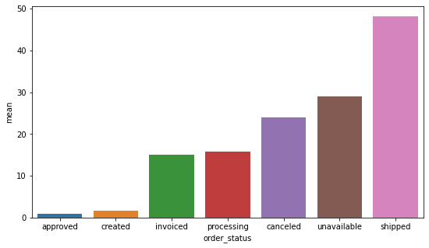
Bar chart of the average number of orders per month depending on the reason.
2. On average, how many orders are not delivered per month for various reasons (display details for reasons)?

Slide 3
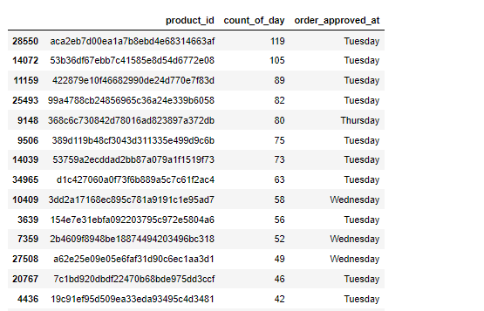
3. For each product, determine on which day of the week the product is most often purchased
First 14 values of the table "Total" for each user and the day of the week with the highest number of purchases of this product

Slide 4
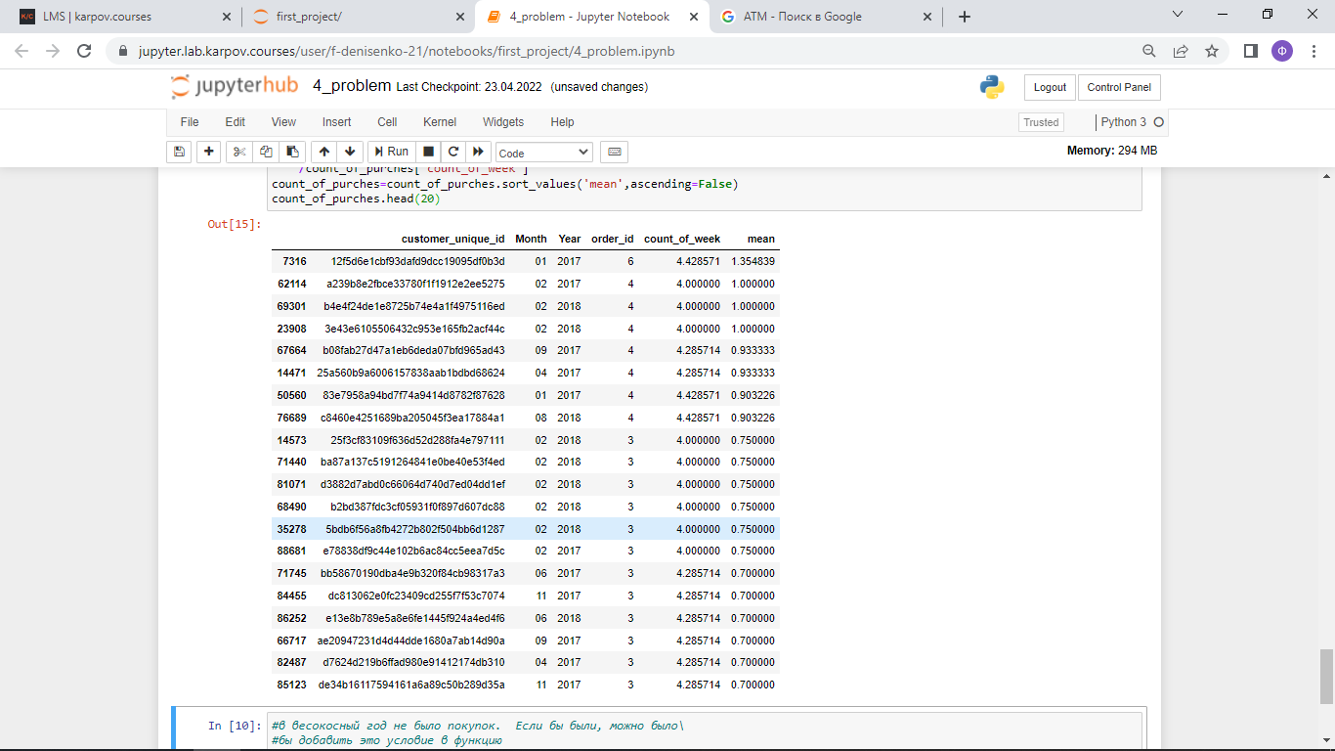
4. How many purchases do each user have on average per week (by month)?
First 20 values of "Count_of_purches_of_purches" in the user table with the average number of purchases for each month

Slide 5
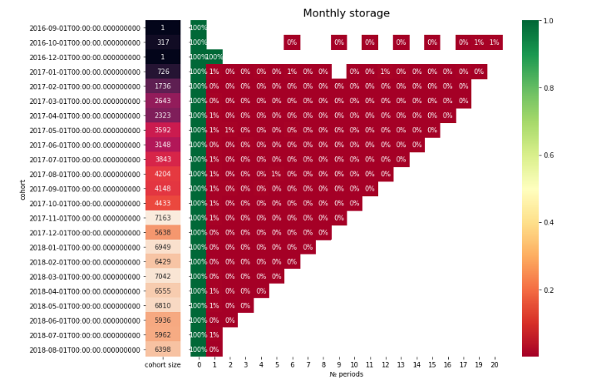
In the period from January to December, identify the cohort with the highest retention for the 3rd month
The cohorts "2017-06-01" have the largest retention for the 3rd month.

Slide 6
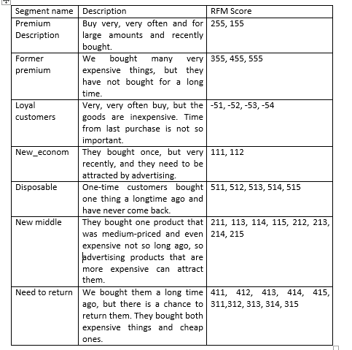
6. Build RFM users segmentation to estimate the audience
Table “Segmentation of customers”

Slide 7
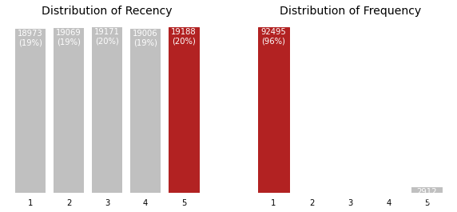
6. Build RFM users segmentation to estimate the audience

Slide 8
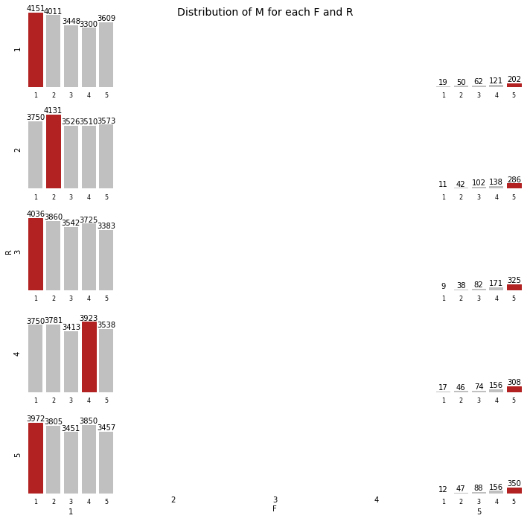

Slide 9
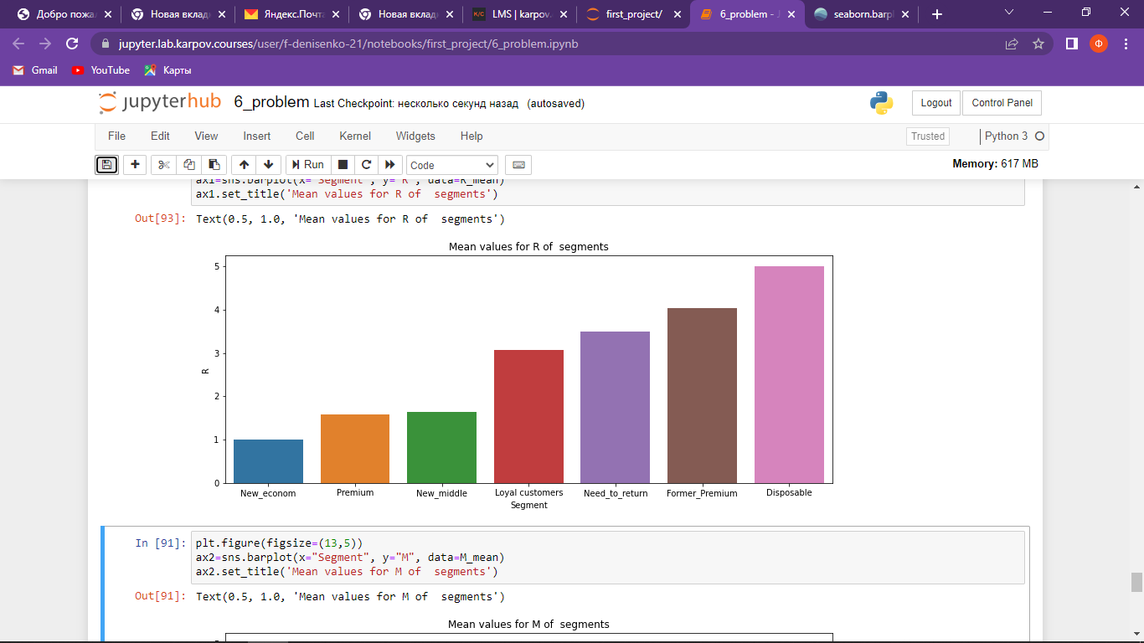
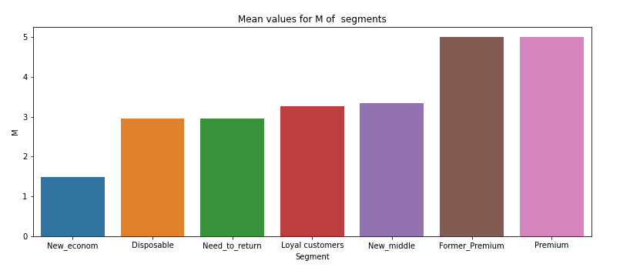
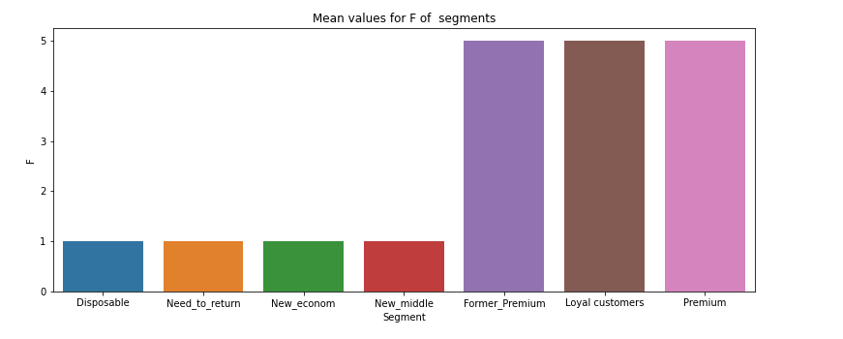
The mean R, F and M values for every segment.

Slide 10
Errors in the data
The data analysis revealed the following anomalie
In the table "olist_order_items_dataset.csv", the number of unique orders “order_id” is 98666. In the table "olist_orders_dtaset.csv", the number of unique orders “order_id” is 99441. These two numbers must match, because it is the same, unique order numbers. This means that there is no data in the table "olist_order_items_dataset.csv".

